Slide 1
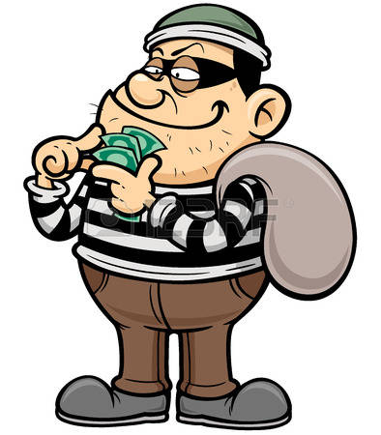
The Bank Robbery
Responsibility

Slide 2
Activity Prep
Put kids in groups of 4 or 5
Each group is given a stack of clues.
Each group needs a piece of paper and a pencil.

Slide 3
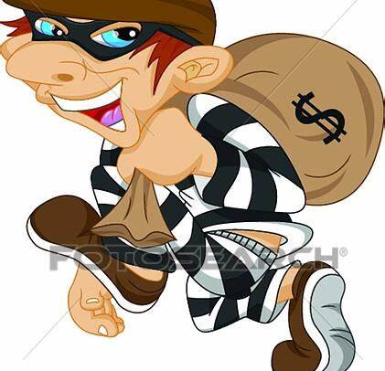
We need your help!
Task: The First National Bank of Minnetonka, Minnesota, was robbed of $1,000,000. Your task is to figure out what person (s) did it using the clues provided.

Slide 4
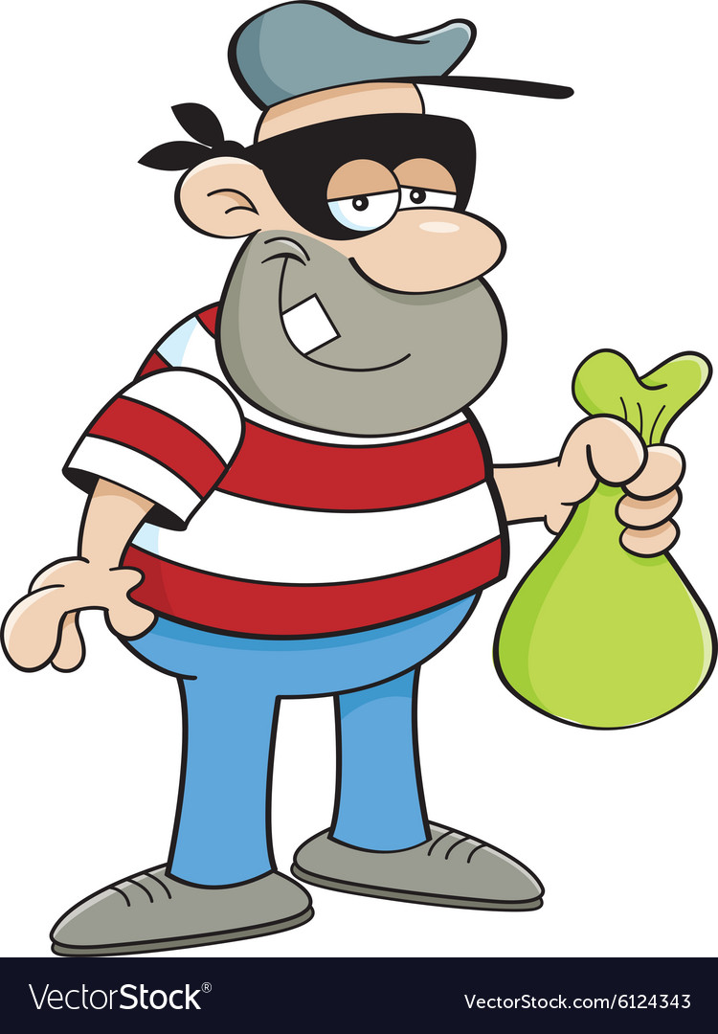
Will you be able to solve the crime?
You have 20 minutes! Work with your group to find out who robbed the bank! If you put all the clues together you can solve the mystery. Anytime your group thinks they know the answer, and your group agrees, you may tell the teacher. Remember, you need to have all the parts of the robbery correct to complete the task!

Slide 5
Discussion Questions: Please answer these questions after finding out who robbed the bank.
How were decisions made in your group?
Was a leader needed?
Was time lost getting organized?
Were attempts made to encourage the participation of all members?
Did anyone monopolize the discussion? Was this productive for the group?
How did you organize the information to solve the mystery - time, person, location, etc?
Could you have organized the information more efficiently?

